Slide 1
The Way We Worship
One of Jesus temptations in the wilderness was to take a passage of scripture at face value and misapply it
– His response was to say
“IT IS ALSO WRITTEN”
Matt. 4:7 NIV
This principle is applied here to investigate the passages at the end of the Old Testament which contradict other teachings of the Bible

Slide 2
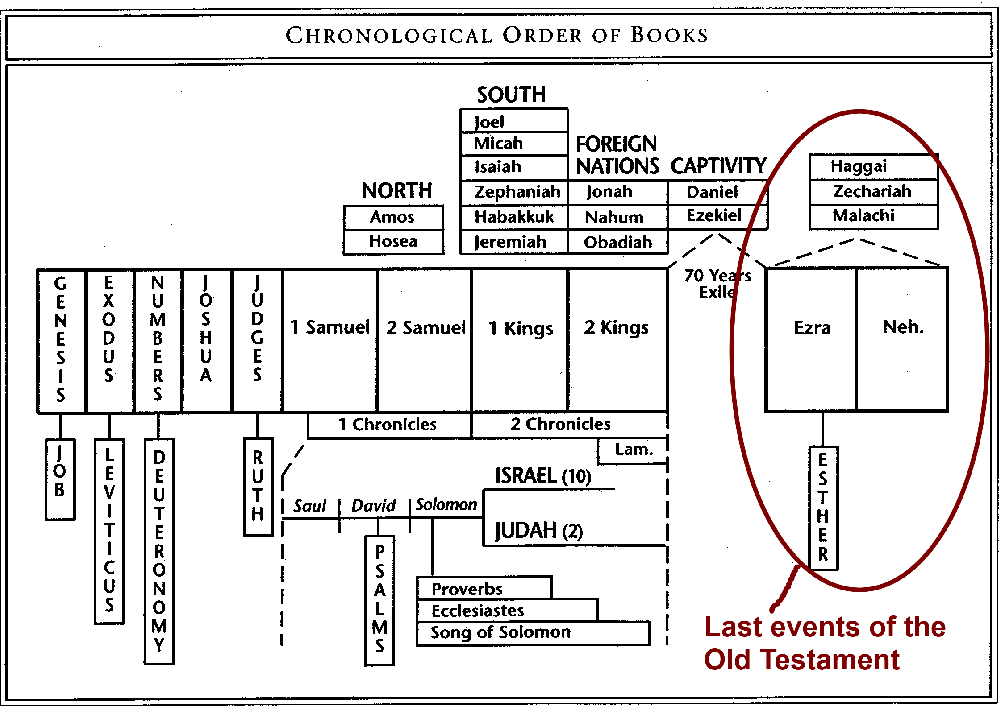
The Way We Worship - Last Events of Old Testament

Slide 3
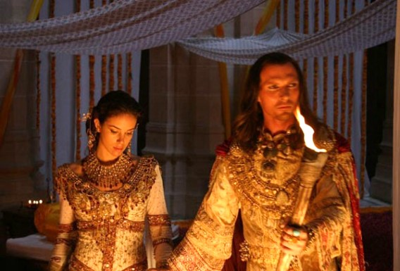
Background - Ezra – Nehemiah were originally one book It covered the period from approx 538 BC – 432BC
538 BC - Zerubbabel led 1st return to Jerusalem – Ezra 2:2
520 BC – Haggai/Zechariah Prophesy
516 BC - Temple completed in Jerusalem - Ezra 6:15
6th year Darius Prophet Zechariah contemporary Ezra 6:15
486 BC – Letter written to Xerxes – Ezra 4:6
479 BC – Esther* made queen in Persia – Esther 2:16
465 BC – Artaxerxes King in Persia
458 BC – Ezra led a 2nd return
445 BC – Nehemiah led a third return
432 BC – Last memoirs of Nehemiah
Prophet Malachi

Slide 4

*NOTE
While the Jewish leaders in Jerusalem were declining offers from foreigners to help build the temple, and later forcing Jewish men to send away foreign wives and children (or else they would lose their land)...
Back in Persia
Esther the Jewish girl married a FOREIGN King and saved the nation!
(There are different opinions whether it was Xerxes or Artaxerxes Esther married. The description of the greatness of the Kingdom in Esther 1:1 would indicate it was Xerxes)

Slide 5

The Closing Scenes
The books of Esther and Ezra/Nehemiah are the last history books of the Old Testament. Their words are recorded for our learning in the same way as the words of Eliphaz to Job.
Job 15:5 “Your sin prompts your mouth; you adopt the tongue of the crafty.” (The incorrect opinion of Eliphaz)
When Ezra records that foreigners are “enemies” that is the opinion of the Jewish leaders - left for our learning. Zechariah disagreed.
Ezra/Nehemiah is never quoted in the New Testament.
The moral judgments about the actions of Ezra and Nehemiah came from God came via Zechariah and Malachi - His prophets of the time – and from John the Baptist and Jesus, after a long period of “night without vision” as Micah 3 had foretold.

Slide 6
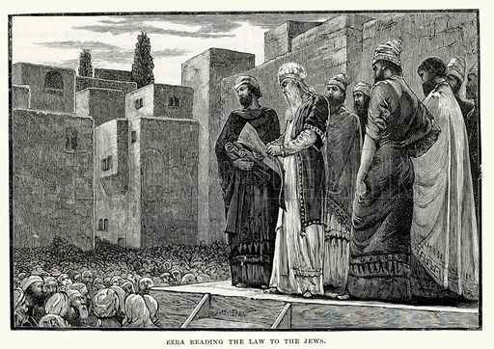
Last Events of Old Testament THE GREAT DIVORCE – under Ezra
Ezra 10:2.. “Now let us make a covenant before our God to send away all these (foreign) women and their children, in accordance with the counsel of my lord and of those who fear the commands of our God. Let it be done according to the Law....15 Only Jonathan son of Asahel and Jahzeiah son of Tikvah, supported by Meshullam and Shabbethai the Levite, opposed this.”
Consider the possibility that the group in verse 15 who opposed the great divorce are right to do so.
IT IS ALSO WRITTEN
Mal 3:16 “The man who hates and divorces his wife, ” says the Lord, the God of Israel, “does violence to the one he should protect,” says the Lord Almighty.”

Slide 7
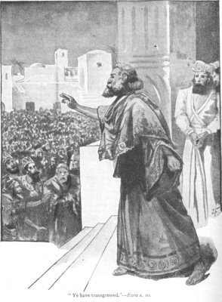
Nehemiah’s FINAL REFORMS
Neh. 13:1-3 “On that day the Book of Moses was read aloud in the hearing of the people and there it was found written that no Ammonite or Moabite should ever be admitted into the assembly of God (from Deut. 23)... When the people heard this law, they excluded from Israel ALL who were of foreign descent.”
“When the people heard THIS Law”
The people took one passage at face value and applied it wrongly.
IT IS ALSO WRITTEN
IN DEUT. 23.....
V 7-8 “You shall not abhor an Edomite, for he is your brother. You shall not abhor an Egyptian, because you were an alien in his land. ⁸ The children of the third generation born to them may enter the assembly of the Lord."
NOT ALL FOREIGNERS WERE TO BE EXCLUDED.
ALSO - V 1 “No one who has been emasculated by crushing or cutting may enter the assembly of the Lord.” (a eunuch)
It seems likely that Nehemiah himself was a eunuch, also Daniel. (no mention of Nehemiah enforcing this law)

Slide 8
“It is Also Written” FOREIGNERS & EUNUCHS
“Let no foreigner who is bound to the LORD say, “The LORD will surely exclude me from his people.” And let no eunuch complain, “I am only a dry tree.”” Isaiah 56.3-5
Note: Jesus applied the prophecies in Isaiah to His own day, not a distant kingdom age...
“Is it not written: ‘My house will be called a house of prayer for ALL nations’? But you have made it ‘a den of robbers.’ Mark 11:17 quoting Isaiah 56:7
“Do not mistreat or oppress a foreigner, for you were foreigners in Egypt.”
Exodus 22:21

Slide 9
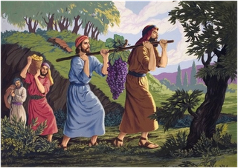
PREVIOUSLY IN OLD TESTAMENT God Accepted Foreigners
Ittai - The Gittite - David said
“Go back...You are a foreigner”
Ittai said “wherever my lord the king may be ...there will your servant be.” 2 Sam 15:21
Obededom – The Gittite (FOREIGNER AS ABOVE) - Cared for the ark (as distinct from Obededom the son of Jeduthun/Levite) It could be that Obededom was given a place amongst the Levites - as Caleb the gentile had a place amongst the tribe of Judah – Or as Samuel an Ephraimite (1 Sam. 1:1) counted as a Levite according to the writer of 1 Chron. 6:16-28.
Ezekiel 47:23 “In whatever tribe a foreigner resides, there you are to give them their inheritance” (written to the house of Israel while in exile for them to contemplate)
CALEB – the Kenizzite Represented the tribe of Judah as one of the 12 spies
Moses wife – a Kennite
Absalom’s mother – Geshurite Princess
SAMSON – fell in love with a Philistine “from the Lord”
MELCHIZEDEK -King of Salem, Canaanite - Priest of God

Slide 10
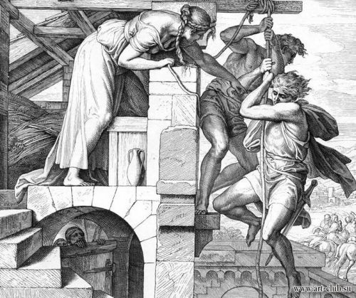
PREVIOUSLY IN OLD TESTAMENT God Accepted Foreigners
Elijah & Elisha sent to Gentiles
“I assure you that there were many widows in Israel in Elijah’s time, ... Yet Elijah was not sent to any of them, but to a widow in Zarephath in the region of Sidon. (Lebanese) And there were many in Israel with leprosy in the time of Elisha the prophet, yet not one of them was cleansed—only Naaman the Syrian.” Luke 4:25
RAHAB – a Canaanite
URIAH – The Hittite
RUTH – Moabitess
Asriel - descended
from Manasseh through his Aramean concubine.
ASENATH – Egyptian - mother of Ephraim and Manasseh
Children of Jacob by ethnically 'Arabic‘ servant girls
This is what the Sovereign Lord says to Jerusalem: Your ancestry and birth were in the land of the Canaanites; your father was an Amorite and your mother a Hittite. Ezek. 16:3
Genealogy of Jesus includes: Tamar, Rahab, Ruth - mentions Uriah

Slide 11
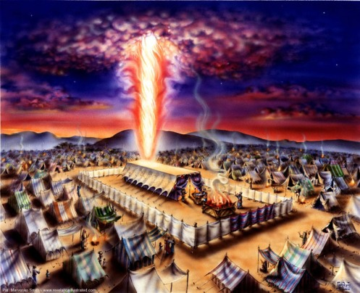
Previously in Old Testament No Partiality
The Tabernacle -
No separate court for Gentiles or Women
SACRIFICES – Numbers 15:14 “Native-born Israelites and foreigners are equal before the LORD and are subject to the same decrees. This is a permanent law for you, to be observed from generation to generation.”
PASSOVER – Exodus 12:48 “A foreigner residing among you who wants to celebrate the Lord’s Passover must have all the males in his household circumcised; then he may take part like one born in the land.”

Slide 12
FOREIGNERS
AS ENEMIES
AS FRIENDS
Zerubbabel was supposed to lay the foundation and cap stone of the temple (be there at start & finish). His refusal to let foreigners help meant the project was delayed. He disappeared from history before the temple was finished.
Ezra 4:1-3 “When the enemies of Judah* and Benjamin heard that the exiles were building a temple for the Lord, the God of Israel, they came to Zerubbabel and to the heads of the families and said, “Let us help you build because, like you, we seek your God and have been sacrificing to him since the time of Esarhaddon king of Assyria, who brought us here.”
But Zerubbabel, Joshua and the rest of the heads of the families of Israel answered, “You have no part with us in building a temple to our God. We alone will build it for the Lord”
The rejected foreigners at this stage were Rehum (Persian governor of Samaria), Shimshai, the judges, officials, administrators over the deportees and the other people. (Ezra 4:9-10)
By contrast- David was the friend of foreigners and Solomon let gentiles help build the first temple.
2 Sam 5:11 ”Now Hiram king of Tyre sent envoys to David, ...they built a palace for David. Then David knew that the Lord had established him as king over Israel and had exalted his kingdom.”
1 Kings 5: 6 “My men will work with yours, ... You know that we have no one so skilled in felling timber as the Sidonians.”
When Hiram heard Solomon’s message, he was greatly pleased and said, “Praise be to the Lord today, for he has given David a wise son to rule over this great nation.”
*Enemies from Ezra’s perspective

Slide 13
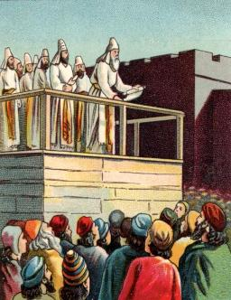
Rebuke from Zechariah during the completion of the temple
4th Year of Darius
6th Year of Darius
The temple was completed without the help offered by foreigners.
Zech. 7:9-12 ‘Administer true justice; show mercy and compassion to one another. Do not oppress the widow or the fatherless, the foreigner or the poor. Do not plot evil against each other.’
But they refused to pay attention; stubbornly they turned their backs and covered their ears. They made their hearts as hard as flint and would not listen to the law or to the words that the Lord Almighty had sent by His Spirit through the earlier prophets.

Slide 14
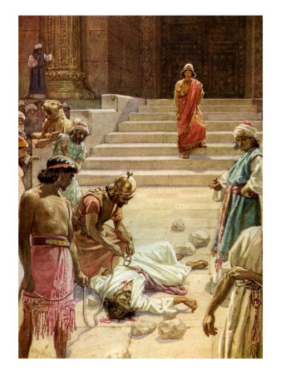
What became of the prophet Zechariah Son of Berekiah ?
Jesus tells us - “Woe to you, teachers of the law and Pharisees, you hypocrites!
Matt 23:35 “Upon you will come all the righteous blood that has been shed on earth, from the blood of righteous Abel to the blood of Zechariah son of Berekiah, whom you murdered between the temple and the altar.”
UNSOLVED MYSTERY...WHICH TEACHERS OF THE LAW MURDERED ZECHARIAH approx 460-480 BC?
.

Slide 15
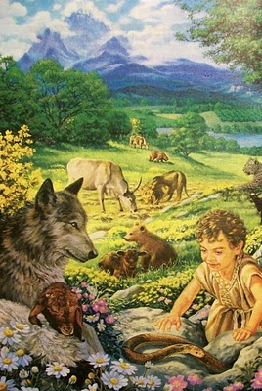
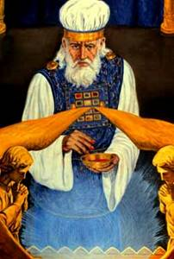
What did Zechariah say to anger the Jews so much they would kill him?
Perhaps it was his last prophesy- Zech 14:21
“On that day holy to the Lord will be inscribed on the bells of the horses, and the cooking pots in the Lord’s house will be like the sacred bowls in front of the altar. Every pot in Jerusalem and Judah will be holy to the Lord Almighty, and all who come to sacrifice will take some of the pots and cook in them.”
“Holy to the Lord” was previously reserved for the gold band worn on the high priests turban (Ex.28:36-38) but Zechariah was saying that every pot in Jerusalem and Judah would be “holy to the Lord” and FOREIGNERS would come and do their own sacrifices and cook in the pots themselves – holiness would no longer be just for the priests...
Everyone and
thing on God’s
Holy Hill will
be Holy

Slide 16
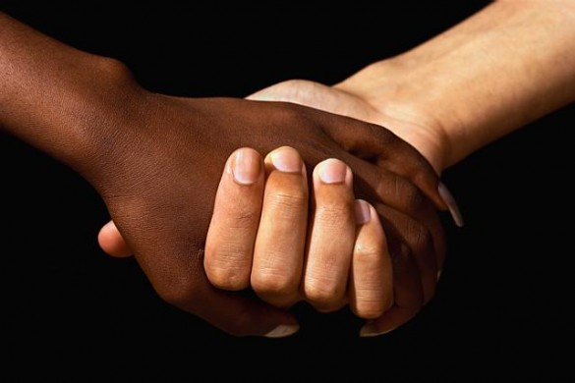
Zechariah’s final verse ch. 14:21 . “And on that day there will no longer be a Canaanite in the house of the Lord Almighty”
The distinction between Jew and foreigner will finally be gone. For those living the “kingdom life” it shouldn’t exist now.
Gal. 3:26-29 “ So in Christ Jesus you are all children of God through faith, for all of you who were baptized into Christ have clothed yourselves with Christ. There is neither Jew nor Gentile, neither slave nor free, nor is there male and female, for you are all one in Christ Jesus. If you belong to Christ, then you are Abraham’s seed, and heirs according to the promise.”
Those who may dwell on God’s holy hill
Are the righteous
-Regardless of race, gender, tribe
Psalm 15 “Lord, who may dwell in your sacred tent? Who may live on your holy mountain?
The one whose walk is blameless, who does what is righteous, who speaks the truth from their heart;
whose tongue utters no slander, who does no wrong to a neighbour, and casts no slur on others;
who despises a vile person but honours those who fear the Lord; who keeps an oath even when it hurts, and does not change their mind;
who lends money to the poor without interest; who does not accept a bribe against the innocent.”

Slide 17
Mystery of Zechariah’s Murder
The book of Ezra/Nememiah covered the history of Jerusalem during the period from approx 538 BC – 432BC but leaves out the murder of Zechariah Son of Berekiah, Son of Iddo, who was murdered in Jerusalem during that time.
Zechariah was a “young man” in 520 BC (Zech. 2:3)
As well as Jesus confirmation of this event in Matt. 23:35 “Zechariah son of Berekiah, whom you murdered between the temple and the altar.” - There is also a reference to it in the Targum on Lamentations 2:20
"Is it right to kill priest and prophet in the Temple of the Lord, as when you killed Zechariah son of Iddo, the High Priest and faithful prophet in the Temple of the Lord on the Day of Atonement because he told you not to do evil before the Lord?" Cited with permission from English translation by C.M.M. Brady
Zechariah’s murder is a witness against those who carried it out – their house would be left desolate until they say ‘Blessed is he who comes in the name of the Lord.’ (Matt. 23:38)

Slide 18
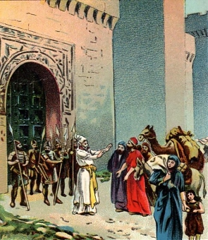
Gates shut or Open?
Malachi/Isaiah
Nehemiah
Neh. 13:19 “When evening shadows fell on the gates of Jerusalem before the Sabbath, I ordered the doors to be shut and not opened until the Sabbath was over. ... Once or twice the merchants and sellers of all kinds of goods spent the night outside Jerusalem. But I warned them and said, “Why do you spend the night by the wall? If you do this again, I will arrest you.”
Mal. 1:10 “Among you the doors shall be shut, and one will not kindle the fire of mine altar for nothing, I have no pleasure in you, saith the Lord Almighty, and I will not accept a sacrifice at your hands. 11 For from the rising of the sun even to the going down thereof my name has been glorified among the Gentiles; and in every place incense is offered to my name, and a pure offering: for my name IS great among the Gentiles, saith the Lord Almighty. ” (Septuagint)
Isaiah 60:10 “Foreigners will rebuild your walls, and their kings will serve you...
Your gates will always stand open, they will never be shut, day or night,
Matt. 23:13 “You shut the door of the kingdom of heaven in people’s faces. You yourselves do not enter, nor will you let those enter who are trying to.”

Slide 19
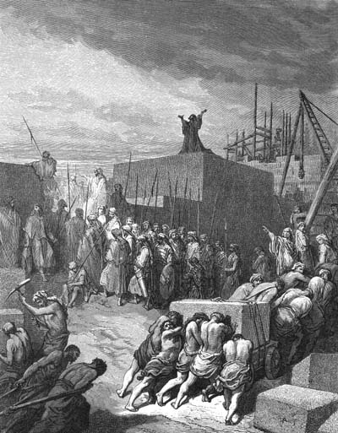
Nehemiah built physical walls God cared about the spiritual ones
Ne. 1:3-4 “The wall of Jerusalem is broken down, and its gates have been burned with fire. ” When I heard these things, I sat down and wept. For some days I mourned and fasted and prayed before the God of heaven.”
COMPARE TO
Isaiah 58:5 “Is not this the kind of fasting I have chosen: to loose the chains of injustice and untie the cords of the yoke, to set the oppressed free and break every yoke? Is it not to share your food with the hungry and to provide the poor wanderer with shelter , when you see the naked, to clothe them?”
Ezek. 22:29 “They oppress the poor and needy and mistreat the foreigner, denying them justice.
I looked for someone among them who would build up the wall and stand before me in the gap on behalf of the land so I would not have to destroy it, but I found no one.”
WHAT COULD HAVE BEEN - AND WILL BE
Zech 2:4 ‘Jerusalem will be a city without walls because of the great number of people and animals in it. And I myself will be a wall of fire around it,’ declares the Lord, ‘and I will be its glory within.’

Slide 20
People Ezra & Nehemiah Perceived as Enemies
Rehum the commanding officer (Governor Samaria), Shimshai the secretary, the rest of their associates -the judges, officials and administrators over the people from Persia, Uruk and Babylon, the Elamites of Susa, and the other people deported and settled in the city of Samaria. Ezra 4:9-10
Daughters of Canaanites, Hittites, Perizzites, Jebusites, Ammonites, Moabites, Egyptians and Amorites. Ezra 9:1
Sanballat the Horonite (Moabite), Tobiah the Ammonite official and Geshem the Arab. Neh. 2:19
The Arabs, the Ammonites and the people of Ashdod. Neh. 4:7
Prophetess Noadiah and the other prophets. Neh. 6:15
The nobles of Judah who kept reporting the good deeds of Tobiah. Neh. 6:14
Those who could not find family records were considered unclean. Neh. 7:64
ALL FOREIGNERS Neh. 9:2
People from Tyre who lived in Jerusalem. Neh. 13:16
Foreign women Neh. 13:27
Son of Joiada son of Eliashib the high priest who was son-in-law to Sanballat the Horonite. Neh. 13:28
“Thus cleansed I them from all strangers” Neh. 13:30
WE ARE NOT TOLD THAT
GOD REGARDED THESE PEOPLE AS ENEMIES and to do so contradicts other Bible teachings

Slide 21
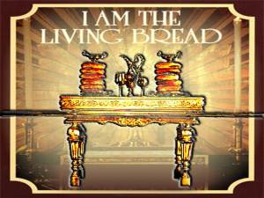
THE LORD’S TABLE
God said via Malachi
Mal 1:11 “Oh, that one of you would shut the temple doors, so that you would not light useless fires on my altar! I am not pleased with YOU,” says the Lord Almighty, “and I will accept no offering from your hands. YOU profane my name by saying, ‘The Lord’s table is defiled...my name is to be feared among the nations.”
David shared the shewbread with his men – the criteria- “being committed to God” – not whether they were foreigners. 1 Sam. 23:5
Examples of David’s men:
Uriah the Hittite, Ittai the Gittite, Zelek the Ammonite, Jebosthe (chief among the captains) the Chananite (Canaanite) 2 Sam 23:8 (Septuagint)
Ithma the Moabite
JESUS SAID “I am the living bread” John 6:51
Nehamiah said the Lord’s table was defiled by foreigners....
Neh 13:6 Here I learned about the evil thing Eliashib had done in providing Tobiah a room in the courts of the house of God. I was greatly displeased and threw all Tobiah’s household goods out of the room. I gave orders to purify the rooms... So I purified the priests and the Levites of everything foreign, and assigned them duties, each to his own task. I also made provision for contributions of wood at designated times”

Slide 22

Noadiah & The other Prophets A Silent Witness
The book of Nehemiah is written from Nehemiah’s perspective. We are not told that his words and actions had God’s approval.
It’s the last history book of the Old Testament and the voice of God was silent in Israel for the next 430 years. Zechariah and Malachi – God’s prophets- condemn the actions of the time.
We don’t hear the silent voices of Noadiah and the other prophets who opposed Nehemiah. We only know that they, and many others objected to his actions and the actions of Ezra.
Neh. 6:14 “Remember also the prophetess Noadiah and how she and the rest of the prophets have been trying to intimidate me.”

Slide 23
Connection between Chronicles & Ezra/Nehemiah There seems to be a commonality in these 3 books. All promote the southern tribes of Judah and Benjamin and omit positive things about foreigners. All omit negative things about Jews. Ezra gives added emphasis that God dwells in Jerusalem in Judah.
END OF CHRONICLES
BEGINNING OF EZRA
2 Chron. 36:22-23
In the first year of Cyrus king of Persia, in order to fulfill the word of the Lord spoken by Jeremiah, the Lord moved the heart of Cyrus king of Persia to make a proclamation throughout his realm and also to put it in writing:
“This is what Cyrus king of Persia says:
“‘The Lord, the God of heaven, has given me all the kingdoms of the earth and he has appointed me to build a temple for him at Jerusalem in Judah. Any of his people among you may go up, and may the Lord their God be with them.’”
Ezra 1:1-3
In the first year of Cyrus king of Persia, in order to fulfill the word of the Lord spoken by Jeremiah, the Lord moved the heart of Cyrus king of Persia to make a proclamation throughout his realm and also to put it in writing:
“This is what Cyrus king of Persia says:
“‘The Lord, the God of heaven, has given me all the kingdoms of the earth and he has appointed me to build a temple for him at Jerusalem in Judah. ³ Any of his people among you may go up to Jerusalem in Judah and build the temple of the Lord, the God of Israel, the God who is in Jerusalem, and may their God be with them.”

Slide 24
Chronicles has a pro-Jewish focus
CHRONICLES
SAMUEL & KINGS
1 Kings 9:11 Solomon gave 20 towns in Galilee to Hiram king of Tyre
2 Sam. 24:1 God incited David
1Kings 17:1 “Elijah the Tishbite, who was of the foreigners of Gilead” (Word English Bible) Who also went to the widow of Lebanon
2 Sam 7:6 Whereas I have not dwelt in any house since the time that I brought up the children of Israel out of Egypt, even to this day
2 Chron. 8:2 Hiram gave towns to Solomon
I Chronicles 2 1:1 Satan incited David
The writer of Chronicles excluded any mention of Elijah, Elisha and their gentile converts mentioned in Luke 4:25
1 Chron 17:5 For I have not dwelt in a house since the day that I brought up Israel unto this day
The kings of Israel in the North are barely mentioned
The kings of Judah are recorded with their “bad” history left out (eg. David’s sin with Bathsheba)

Slide 25
Scripture is for our learning Jesus encouraged us to compare scripture with scripture and to perceive the message
In omitting to say that Israel came out of Egypt, and adding that God dwells in Jerusalem (inferring it’s the only place He dwells) perhaps the Chronicler was trying to stress the connection of the Jews to the land of Canaan, rather than to let them appear as a foreign people who came from Egypt. This would be especially important in Nehemiah and Ezra’s time when they were excluding foreigners and forcing men to send away their foreign wives and children.

Slide 26
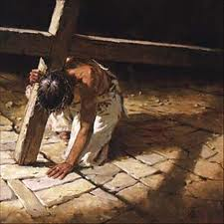
Isaiah 50:6 “I offered my back to those who beat me, my cheeks to those who pulled out my beard” Who beat and pulled hair out?
Two people named in Old Testament who carried out this behaviour...
Ezra 9:3 “When I heard this, I tore my tunic and cloak, pulled hair from my head and beard and sat down appalled.”
Nehemiah 13:25 “I rebuked them and
called curses down on them. I beat some of
the men and pulled out their hair.”
Their descendants (Scribes and Pharisees)
did the same thing to Jesus

Slide 27
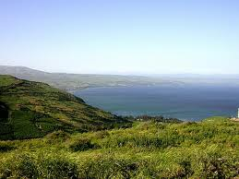
Gentiles were to be Blessed Galilee of the Gentiles
Isaiah 9:2 “In Galilee of the Gentiles, the people who walked in darkness have seen a great light; Those who dwelt in the land of the shadow of death, Upon them a light has shined.”
LEBANON
BLESSED “And I will bring them to the land of Gilead and to Lebanon, till there is no room for them.” Zech. 10:10

Slide 28
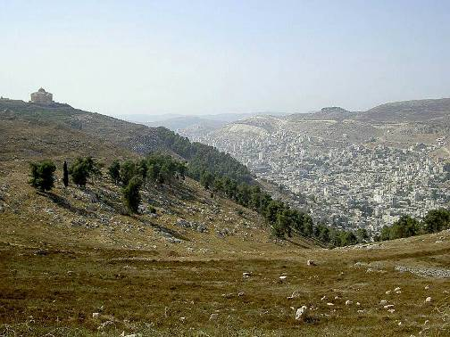
Where did Sanballat Go?
Neh. 13:28 “One of the sons of Joiada son of Eliashib the high priest was son-in-law to Sanballat the Horonite. And I drove him away from me.”
He went with a group of priests, built a temple and woshipped God on Mt Gerizim
FROM ISRAEL ANTIQUITIES AUTHORITY
National Campus for Archaeology of Israel
“Today we can state with certainty that the first phase of the temple on Mount Gerizim was erected in the middle of the fifth century BCE by Sanballat the Horonite, a contemporary of Ezra and Nehemiah... Sanballat the Horonite who was a governor of Samaria on behalf of the Persian Empire – decided to build a temple to a supreme god on Mount Gerizim, which was sacred to both the people of Samaria and the people of Judah, and thus severe all ties with Jerusalem and its temple. He decided to wed his daughter to a scion of the high priesthood in Jerusalem thereby making all his descendants priests from the sect of the Jerusalem priesthood. It seems that along with the grandson of Eliashib the Priest other Judean priests came to Mount Gerizim where they built and sanctified the temple as a replica of the Jerusalem temple.”

Slide 29
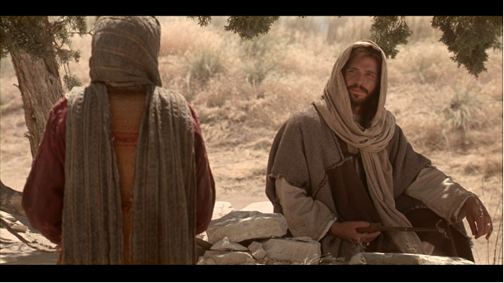
WHERE WE WORSHIP
EZRA
JESUS
Ezra focussed his worship on Jerusalem and the tribes of Judah, Benjamin and part of Levi.
Ezra 1:3 “Any of his people among you may go up to Jerusalem in Judah and build the temple of the Lord, the God of Israel, the God who is in Jerusalem”
Jesus said the place of worship doesn’t matter, but HOW you worship.
John 4:20 “Our ancestors worshiped on this mountain, but you Jews claim that the place where we must worship is in Jerusalem.” “Woman,” Jesus replied, “believe me, a time is coming when you will worship the Father neither on this mountain nor in Jerusalem...a time is coming and has now come when the true worshipers will worship the Father in Spirit and in truth”

Slide 30
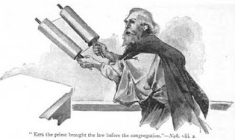
Records Mattered to Jews But Way of Worship mattered GOD
JEWS
Zechariah
Ezra 2:62 “These searched for their family records, but they could not find them and so were excluded from the priesthood as unclean.”
- This is in contrast to the KINGDOM of Priests they could have been
Zech 6:15 “Those who are far away will come and help to build the temple of the Lord.”
THIS PROPHECY WAS CONDITIONAL
“This shall come to pass, if ye will diligently hearken to the voice of the Lord your God.”
John the Baptist
Luke 3:8 “Do not begin to say to yourselves, ‘We have Abraham as our father.’ For I tell you that out of these stones God can raise up children for Abraham.”

Slide 31
A Conditional Promise Nation of PRIESTS - not just males from tribe of Levi
PRIESTS FROM ALL NATIONS
MEN & WOMEN
Revelation 5:9 “Because you were slain, and with your blood you purchased for God persons from every tribe and language and people and nation. You have made them to be a kingdom and priests to serve our God,and they will reign on the earth.”
TRIBE, NATIONALITY, GENDER NO LONGER MATTER – THEY NEVER DID –What matters to God is the way we worship
God always approved of women prophets and judges – it was traditions of men which made them a minority.
TO NATURAL ISRAEL
Exodus 19:4 “Now IF you obey me fully and keep my covenant, then out of all nations you will be my treasured possession ...you will be for me a kingdom of priests and a holy nation.”
TO SPIRITUAL ISRAEL – Women & Gentiles included
1 Pet. 2:9 “You are a chosen people, a royal priesthood, a holy nation, God’s special possession”

Slide 32
Ezra’s Genealogy
Ez. 7:1-6 “Ezra son of Seraiah, the son of Azariah, the son of Hilkiah, the son of Shallum, the son of Zadok, the son of Ahitub, the son of Amariah, the son of Azariah, the son of Meraioth, the son of Zerahiah, the son of Uzzi, the son of Bukki, the son of Abishua, the son of Phinehas, the son of Eleazar, the son of Aaron the chief priest— this Ezra came up from Babylon.
He was a teacher well versed in the Law of Moses”
Nicodemas was also a “Teacher of the Law” - Jesus said to him that genealogies of men don’t count - John 3:3 “No one can see the kingdom of God unless they are born again (from above).”
Elijah’s Genealogy
“Elijah the Tishbite who was of the sojourners of Gilead”
A voice in the wilderness

Slide 33
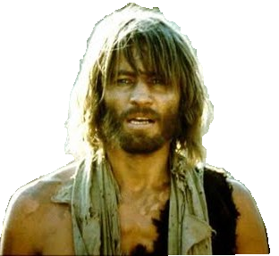
ELIJAH – The Stranger
1Kings 17:1 “And Elijah the Tishbite , who was of the inhabitants of Gilead”.
Inhabitant =“TOWSHAB”
Towshab – Occurs 14 times in Old Test.
Translated 13 times - sojourner/stranger/foreigner 1 time – inhabitant
STRANGERS IN A FOREIGN COUNTRY
ELIJAH the Tishbite, who was of the foreigners/sojourners of Gilead
ABRAHAM made his home in the promised land like a stranger in a foreign country Heb. 11:9
DAVID - I am a foreigner to my own family, a stranger to my own mother’s children
Psalm 69:8

Slide 34

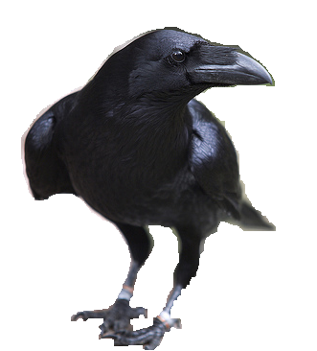
NEW TESTAMENT MESSAGE ABOUT ELIJAH
A remnant saved by grace
Romans 11:4 “God’s answer to him? “I have reserved for myself seven thousand who have not bowed the knee to Baal.” So too, at the present time there is a remnant chosen by grace. And if by grace, then it cannot be based on works; if it were, grace would no longer be grace.”
Elijah & Elisha sent to Gentiles
“I assure you that there were many widows in Israel in Elijah’s time, ... Yet Elijah was not sent to any of them, but to a widow in Zarephath in the region of Sidon. (Lebanese) And there were many in Israel with leprosy in the time of Elisha the prophet, yet not one of them was cleansed—only Naaman the Syrian.”
Luke 4:25
Even in Elijah’s time God’s message was given
to the gentiles and those in Israel saved by grace
- Not works of Law

Slide 35
THE GOD OF ELIJAH
Heb. 11:13-16 “They did not receive the things promised; they only saw them and welcomed them from a distance, admitting that they were foreigners and strangers on earth...Therefore God is not ashamed to be called their God, for he has prepared a city for them.”
God was called the “God of Elijah” in 2 Kings 2:14
ELIJAH means “My God is Jehovah”
In a world of Baal worship – Elijah’s name proclaimed His worship of God
Not his lineage in natural Israel

Slide 36
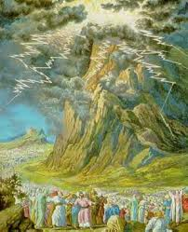
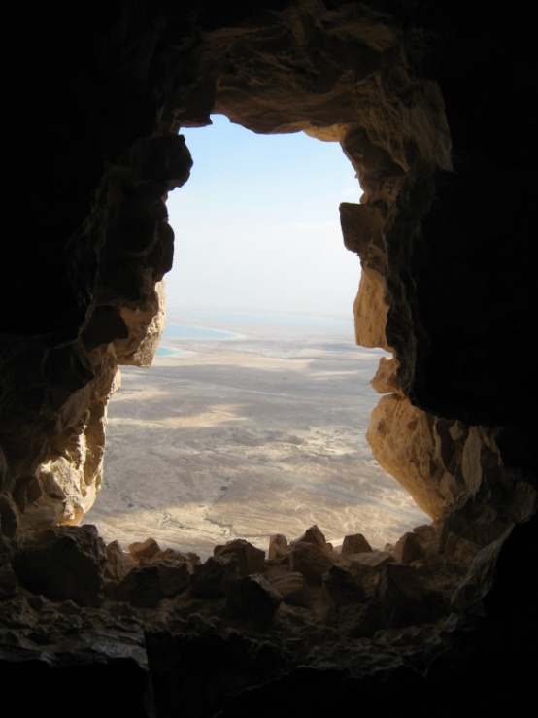
Last words of Old Testament
Mal. 4:5-6 “I will send to you Elias the Thesbite, before the great and glorious day of the Lord comes; who shall turn again the heart of the father to the son, and the heart of a man to his neighbour” (Septuagint)
God also appeared to Elijah at Horeb , as He had to Moses. He was no longer in the earthquake wind and fire. He was with any who didn’t bow the knee to Baal, who came to Him in faith. He was now in the still small voice heard by Elijah and those of faith as He always had been – both Jews and Gentiles.

Slide 37
ELIJAH will “Turn again the heart of the father to the son, and the heart of a man to his neighbour” (Septuagint) Mal.4:5-6 “Who is my neighbour?” Luke 10:29
Jesus explained who a “neighbour” is in the parable of the good Samaritan – Ezra & Nehemiah did not consider Samaritans to be neighbours.
By contrast Jesus mixed with people others despised. He taught that barriers must come down and true righteousness be discerned. It’s not who we mix with that contaminates us but how we think and how we worship. Despising others is wrong worship. Loving your neighbour as yourself is right worship.
Zechariah told Joshua the priest and his associates that they were supposed to build a temple that was welcoming – they didn’t build such a place - but another is - “the Branch” (Jesus).
“In that day, says the Lord Almighty, you shall call together every man his neighbour under the vine and under the fig-tree.” Zech. 3:10 (Septuagint)

Slide 38
Robin Jones
alsowritten@hotmail.com

