Slide 1
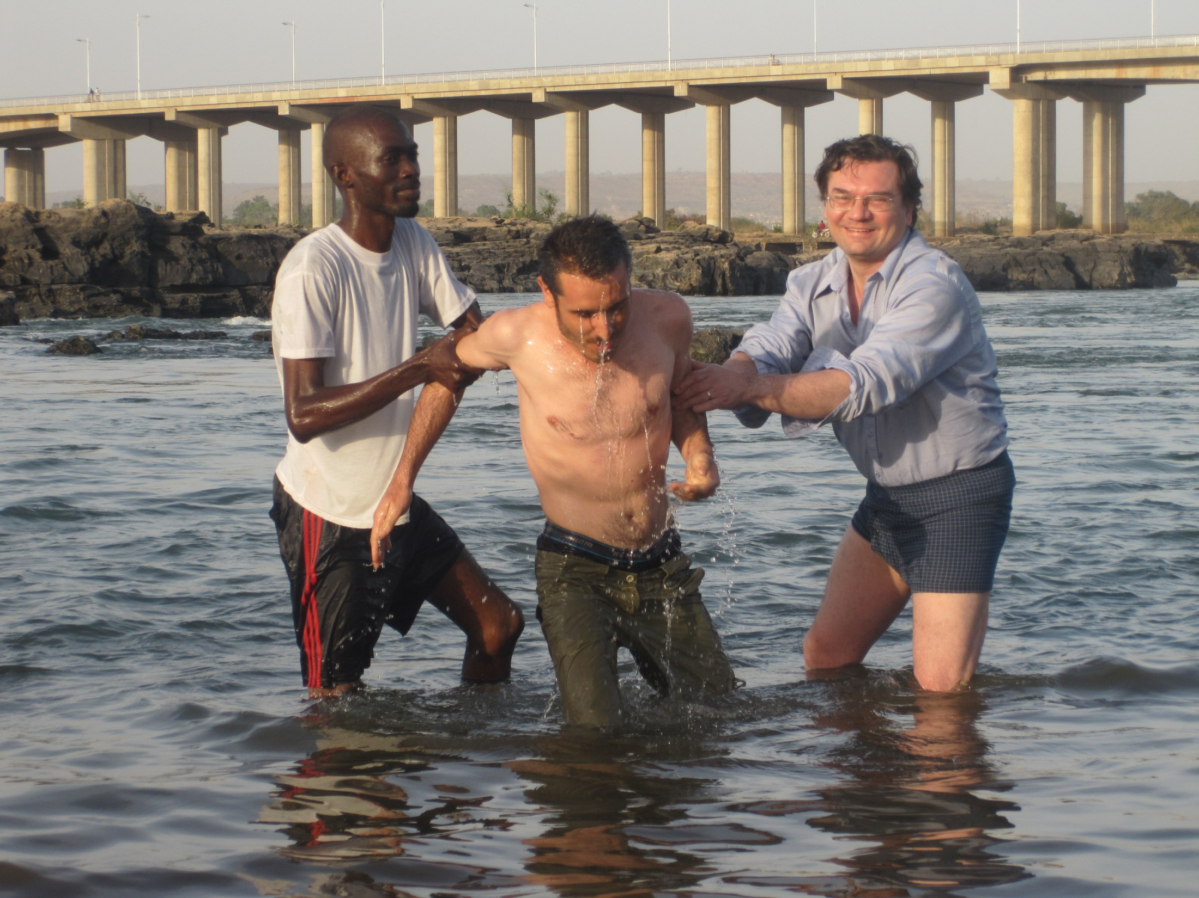
MISINGI YA BIBLIA SOMO LA 10 Kubatizwa Katika Jina La Yesu

Slide 2
Maana Muhimu Sana Ya Ubatizo
Heb. 6:2 speaks of baptism as one of the most basic doctrines
Ebra 6:2 unazungumzia ubatizo kuwa ni moja ya mafunzo ya msingi sana.

Slide 3
“Salvation is of the Jews” (Jn. 4:22) in the sense that the promises concerning salvation were made only to Abraham and his seed. We can only have those promises made to us if we become in the seed, by being baptised into Christ (Gal. 3:22-29). “Only as many” as have been baptised into Christ are in Him and therefore have the promises of salvation made to Abraham made to them (Gal. 3:27). “Wokovu watoka kwa Wayahudi” (Yohana 4:22) kwa maana ya kwamba ahadi zote kuhusu wokovu zilifanywa kwa Abrahamu pekee na uzao wake. Tunaweza kuwa na ahadi hizo tu zilizofanywa kwetu kama tukiwa ndani ya mzao, kwa kubatizwa katika Kristo (Gal. 3:22-29).

Slide 4
“Go into all the world and preach the gospel to every creature. He who believes and is baptised will be saved” (Mk. 16:15,16). 15Akawaambia, “Enendeni ulimwenguni mwote, mkaihubiri Injili kwa kila kiumbe. 16Ye yote aaminiye na kubatizwa ataokoka.
As the ark saved Noah and his family from the judgment that came upon sinners, so baptism into Christ will save believers from eternal death (1 Pet. 3:20,21).

Slide 5
“Most assuredly, I say to you, unless one is born of water and the Spirit, he cannot enter the kingdom of God” (Jn. 3:5). Yesu akamwambia, ‘‘Amin, amin nakuambia, hakuna mtu ye yote anayeweza kuingia katika Ufalme wa Mungu isipokuwa amezaliwa kwa maji na kwa Roho
Unless we are “washed”, we have “no part” in Christ (Jn. 13:8). Yesu akamjibu, ‘‘Kama nisipokunawisha, wewe huna sehemu nami’’.

Slide 6
The Urgent Need for Baptism
Paul received a dramatic vision from Christ which so pricked his conscience that as soon as possible he “arose and was baptised” (Acts 9:18).
Mtume Paulo alipata maono ya namna ya pekee toka kwa Kristo yalioichoma dhamiri yake hata mara hiyo ilipowezekana …“akasimama, akabatizwa” (Mdo 9:18).

Slide 7
“Brothers, what shall we do? Peter said to them: Every one of you should repent and be baptized in the name of Jesus Christ to the remission of your sins… They that received his word were baptized, and there were added in that day about three thousand people (Acts 2:38-41).
Petro akawajibu, “Tubuni, mkabatizwe kila mmoja wenu abatizwe kwa jina la Yesu Kristo, ili mpate kusamehewa dhambi zenu. nanyi mtapokea kipawa cha Roho Mtakatifu. Kwa kuwa ahadi hii ni kwa ajili yenu na watoto wenu na kwa wale wote walio mbali na kila mtu ambaye Bwana Mungu wetu atamwita amjie.’’ Petro akawaonya kwa maneno mengine mengi na kuwasihi akisema, “Jiepusheni na kizazi hiki kilichopotoka.’’ Wale wote waliopokea ujumbe wa Petro kwa furaha wakabatizwa na siku ile waliongezeka watu wapatao 3,000.

Slide 8
“Immediately” people were baptised after understanding and accepting the Gospel (e.g. Acts 8:12, 36-39; 9:18; 10:47; 16:15).
Ushahidi mkubwa wa muhimu kubatizwa unapatikana kwa namna ambayo taarifa inavyokazia jinsi gani watu mara wakabatizwa baada ya kupokea Injili (k.m. Mdo 8:12, 36-39; 9:18; 10:47; 16:15).

Slide 9
Lidia
Acts 16:14,15: Lydia heeded “the things spoken by Paul. And when she ... (was) baptised…”. It is assumed that anyone who hears and believes the Gospel will be baptised - the baptism is seen as an inevitable part of response to the preaching of the Gospel.
Mmoja wa wale wanawake waliotusikiliza aliitwa Lidia, mfanya biashara wa nguo za zambarau, mwenyeji wa mji wa Thiatira, aliyekuwa mcha Mungu. Bwana akaufungua moyo wake akaupokea ujumbe wa Paulo. 15Basi alipokwisha kubatizwa yeye na watu wa nyumbani mwake, alitukaribisha nyumbani mwake akisema, “Kama mmeona kweli mimi nimemwamini Bwana, karibuni mkae nyumbani mwangu.’’ Naye akatushawishi.

Slide 10
Kornelio / Cornelius
Cornelius was “a devout man and one who feared God…who gave alms generously to the people, and prayed to God always”, but this wasn’t enough; he had to be shown what he must do which he hadn’t done - to believe the Gospel of Christ and be baptised (Acts 10:2,6).
Yeye alikuwa mcha Mungu pamoja na wote wa nyumbani mwake, aliwapa watu sadaka nyingi na kumwomba Mungu daima. .. Yeye anaishi na Simoni mtengenezaji ngozi ambaye nyumba yake iko kando ya bahari.”

Slide 11
How Should We Be Baptized? / Tubatizwe Jinsi Gani?
Complete
Immersion

Slide 12
The Meaning of Baptizo / Neno ‘baptizo’
Neno la Kiyunani ‘baptizo, ambalo limetafsiriwa ‘batiza’ katika Biblia za kiswahili halina maana ya kunyunyuzia; lina maana kamili kuosha na kutumbukiza ndani ya maji. Neno hili limetumika katika daraja bora la waandishi wa Kiyunani kuhusu meli ikizama ni kuwa ‘imebatizwa’ (Yaani, imetota) katika maji. Vile vile limetumika katika kutaja kipande cha nguo kutiwa rangi kwa kuchovya katika maji yenye rangi na kuwa rangi nyingine. Kubadili rangi ya nguo, ni bayana ya kwamba imetumbukizwa kabisa ndani ya maji, kuliko kuwa kugeuka rangi iliyo nyunyuziwa juu yake. Ikiwa kuzamisha kweli ni namna sahihi ya ubatizo inakubalika kwa aya zifuatazo.
Notes:
Baptizo, does not mean to sprinkle; it means to completely wash and immerse in a liquid. This word is used in classical Greek concerning ships sinking and being ‘baptised’ (i.e. submerged) in water, or a bucket being submerged in well water., or to a piece of cloth being dyed from one colour to another by ‘baptising’, or dipping it into a dye. Jn. 13:26 uses the Greek bapto to describe how Jesus dipped a piece of bread in wine.

Slide 13
Enough Water - Stream

Slide 14
Enough Water - Barrel

Slide 15
Enough Water - Bath

Slide 16
Baptism By Immersion Tubatizwe Jinsi Gani?
“John also was baptising in Aenon near Salim, because there was much water there. And they came and were baptised” (Jn. 3:23). “Yohana naye alikuwa akibatiza huko Ainoni, karibu na Salimu, kwa sababu huko kulikuwa na maji tele; na watu wakamwendea wakabatizwa” (Yohana 3:23).
Baptism is a “burial with Christ” (Col. 2:12), which implies a total covering. Ubatizo ni kuzikwa (Kolos 2:12), ambao unadokeza kufunikwa kabisa.

Slide 17
Philip and the Ethiopian “went down into the water...and he baptised him. Now when they came up out of the water...” (Acts 8:38,39). Kwa desturi ya mfano mmoja, Filipo na afisa wa Ethiopia “waliteremka wote wawili majini…… naye akambatiza. Kisha walipopanda kutoka majini…” (Mdo 8:38,39). Kumbuka kwamba, afisa aliomba ubatizo alipoona maji: “Tazama maji haya, ni nini kinachonizuia nisibatizwe?” (Mdo 8:36). Ni hakika ya kwamba huyo mtu asingefanya safari jangwani bila kuwa na kiasi cha maji ya kunywa kama katika chupa. Ikiwa ubatizo ilikuwa ni kwa kunyunyuziwa, basi ungeweza kufanyika pasipokuwa na haja ya maji ya chemi chem ya jangwani.

Slide 18
Jesus, too, was baptised by John in the River Jordan - into the Jordan (Mk. 1:9 RVmg.). “As soon as Jesus was baptised, he went up out of the water” (Mt. 3:13-16NIV). Yesu naye, alibatizwa na Yohana katika mto Yordani: “Naye Yesu alipokwisha kubatizwa mara akapanda kutoka majini” (Math 3:13-16). Ubatizo wa Yesu ni dhahiri ulikuwa wa kuzamishwa ndani ya maji mengi- “aliinuka… toka majini” baada ya kubatizwa. Moja kati ya sababu za Yesu kubatizwa ilikuwa ni kuweka mfano, hivyo kwamba hakuna mtu ataweza kudai bila mzaha ya kwamba anamfuata Yesu pasipo kuiga mfano wake wa kubatizwa katika maji mengi.

Slide 19
Baptism – Beginning of a New Life / Ametuhuisha pamoja na Kristo
“Our old self (way of life) was crucified” along with Christ on the cross (Rom. 6:6 NIV); God “made us alive with Christ” at baptism (Eph. 2:5 NIV). Kwenye ubatizo, “utu wetu wa kale (mtindo wa maisha) umesulubiwa” pamoja na Kriso msalabani (Rum 6:6); Mungu “ametuhuisha pamoja na Kristo” wakati wa kubatizwa (Efe. 2:5).

Slide 20
We still have human nature after baptism, and therefore the fleshly way of life will keep raising its head. The ‘crucifixion’ of our flesh (human nature) is therefore an on-going process which only begins at baptism, hence Jesus told the believer to take up his cross each day and follow him, as it were, in the procession towards Calvary (Lk. 9:23; 14:27). Basi ‘kusulubisha’ mwili wetu ni jambo linaloendelea ambalo lilianza pia kwenye ubatizo, ndivyo alimweleza aaminiye aubebe msalaba wake kila siku na amfuate, kama ilivyokuwa katika maandamano ya kuelekea Kalvari (Lk 9:23; 14:27).

Slide 21
Romans / Rum. 6:3-5
“Hamfahamu ya kuwa sisi sote tuliobatizwa katika Kristo Yesu tulibatizwa katika mauti yake. Basi tulizikwa pamoja naye kwa njia ya ubatizo katika mauti yake, kusudi kama Kristo alivyofufuka katika wafu kwa njia ya utukufu wa Baba, vivyo hivyo na sisi tuenende (yaani, tuishi kila siku) katika upya wa uzima. Kwa maana kama mlivyounganika naye katika mfano wa mauti yake (kwa Ubatizo), kadhalika mtaunganika kwa njia ya kufufuka kwake” (Rum 6:3-5)

Slide 22
Ubatizo / Baptism Kufufuka / Resurrection
“Baptism ... now saves you ... by the resurrection of Jesus Christ” (1 Pet. 3:21 NIV) because our association with Christ’s resurrection to eternal life gives us access to the same at his return. “….. ni ubatizo, unaowaokoa ninyi pia siku hizi …… kwa kufufuka kwake Yesu Kristo” (1Petro 3:21) kwa sababu ya kuunganika kwetu na Kristo ufufuo wake kwa uzima wa milele unatupa njia ile ile akirudi.
It is through sharing in this resurrection, then, that we will finally be saved. Jesus stated this: “Because I live, you will live also” (Jn. 14:19). Yesu alisema kuhusu jambo hili kwa maneno rahisi sana: “Na kwa sababu mimi ni hai, ninyi nanyi mtakuwa hai” (Yohana 14:19).

Slide 23
Arising to a New Life / Ametuhuisha pamoja na Kristo

Slide 24
“Die” with Christ … Live with Christ
“If we died with (Christ), we shall also live with Him. If we endure, we shall also reign with Him” (2 Tim. 2:11,12).
Kwa maana kama tumekufa pamoja naye, tutaishi pia pamoja naye. Kama tukistahimili, pia tutatawala pamoja naye. Kama tukimkana Yeye, naye atatukana sisi.

Slide 25
“We always carry around in our body the death of Jesus, so that the life of Jesus may also be revealed in our body ... because we know that the one who raised the Lord Jesus ... will also raise us with Jesus” (2 Wakorinto / Cor. 4:10,11,14NIV).
Sikuzote twachukua katika mwili kufa Kwake Yesu ili kwamba uzima wa Yesu uweze kudhihirika katika miili yetu. Kwa maana sisi tulio hai sikuzote tumetolewa tufe kwa ajili ya Yesu, ili kwamba uzima wake upate kudhihirishwa katika mwili wetu upatikanayo na mauti… kwa sababu tunajua kwamba Yeye aliyemfufua Bwana Yesu kutoka kwa wafu atatufufua pia na sisi pamoja na Yesu na kutuleta sisi pamoja nanyi mbele Zake.

Slide 26
Paul shared in “the fellowship of (Christ’s) sufferings, being (by his hard experience of life) conformed to His death, if, by any means, I might attain to the resurrection from the dead.” as experienced by Christ (Wafilipi / Phil. 3: 10,11 cf. Gal 6:14).
Nataka nimjue Kristo na uweza wa kufufuka Kwake na ushirika wa mateso Yake, ili nifanane naye katika mauti Yake, ili kwa njia yo yote niweze kufikia ufufuo wa wafu.

Slide 27
www.biblebasicsonline.com www.carelinks.net Email: info@carelinks.net

Slide 28
Somo La 10 : Maswali
Je! tunaweza kuokolewa pasipo kubatizwa?
2. Neno ‘ubatizo’ lina maana gani? a)Kujitoa b)Kunyuziwa maji
c)Imani d)Kutumbukizwa/kuzama katika maji
Maana yake nini Ubatizo ulioelezwa kwa Warumi 6:3-5?
Ni lini yatupasa tubatizwe?
a)Baada ya kujifunza Injili ya kweli na kutubu
Tukiwa watoto wadogo
Baada ya kupendezwa/kuvutiwa na Biblia
Tunapotaka kujiunga na kanisa
Tunabatizwa katika nini?
a)Kanisa linalobatiza
b)Neno la Mungu
c)Kristo
d)Roho mtakatifu
Jambo gani linalofuata baada ya ubatizo? a)Tunakuwa sehemu ya uzao wa Abrahamu b)Hatuta tenda dhambi tena c)Kwa maana dhahiri tunaokolewa muda wote
d)Dhambi zetu zinasamehewa
Je! ubatizo peke yake unatuokoa?
8. Je! tutapokea vipawa vya miujiza ya Roho Mtakatifu baada ya kubatizwa?

Slide 29
Study 10: Questions
1. Do you think you can be saved without baptism?
2. What does the word ‘baptism’ mean?
- Commitment
- Sprinkling
- Belief
- Dipping/immersion
3. What is the meaning of baptism as explained in Rom. 6:3-5?
4. When should we be baptised?
- After learning the true Gospel and repenting
- As a small baby
- After getting interested in the Bible
- When we want to join a church
5. What are we baptised into?
- The church who baptises us
- The word of God
- Christ
- The Holy Spirit
6. Which of the following happens after baptism?
- We become part of Abraham’s seed
- We will never sin again
- We are definitely saved for all time
- Our sins are forgiven
7. Will baptism alone save us?

